Slide 1

TRAFFIC LIGHTS MINI PROJECT
Embedded System (EE3427)

Slide 2
Team Members
Nguyen Dinh Huy
2211208
Dao Nguyen Khoi
2151215
Nguyen Ha Phong Thinh
2151143

Slide 3
TABLE OF CONTENTS
01
04
02
05
03
06
INTRODUCTIONS
FIRMWARE AND FLOWCHART
REQUIREMENTS AND BOM
DEMONSTRATION
IMPLEMENTATION
CONCLUSION

Slide 4


01
INTRODUCTION

Slide 5
INTRODUCTIONS
OVERVIEW
OBJECTIVES
MOTIVATION
Traffic light system includes 2 light poles that communicate wirelessly while supporting real-time synchronization
Automate intersection control, improve traffic flow efficiency, and minimize delays. It offers multiple operation modes to adapt to varying traffic conditions
Traffic congestion in urban areas requires adaptive solutions. This project showcases how embedded systems can enhance traffic management

Slide 6

02
SYSTEM REQUIREMENTS AND BOM

Slide 7
TRAFFIC LIGHTS REQUIREMENTS
ACTIVITY | KEY FEATURES | STATUS
Hardware | Adapter 9V to 5V via ASM1117, stable connections on breadboard | Done
Communication | HC-12 UART at 9600bps, channel 88, stable under 50m with noise | Done
Display | 16x2 I2C LCD, show real-time and mode, update every second | Done
Control | LED brightness varies depending on different mode via GPIO | Done
RTC | DS3231 via I2C, update every second via interrupt apply for automatic switching | Done
Mode Switching | 5 push buttons: Normal, Heavy, Night and Control mode | Done

Slide 8
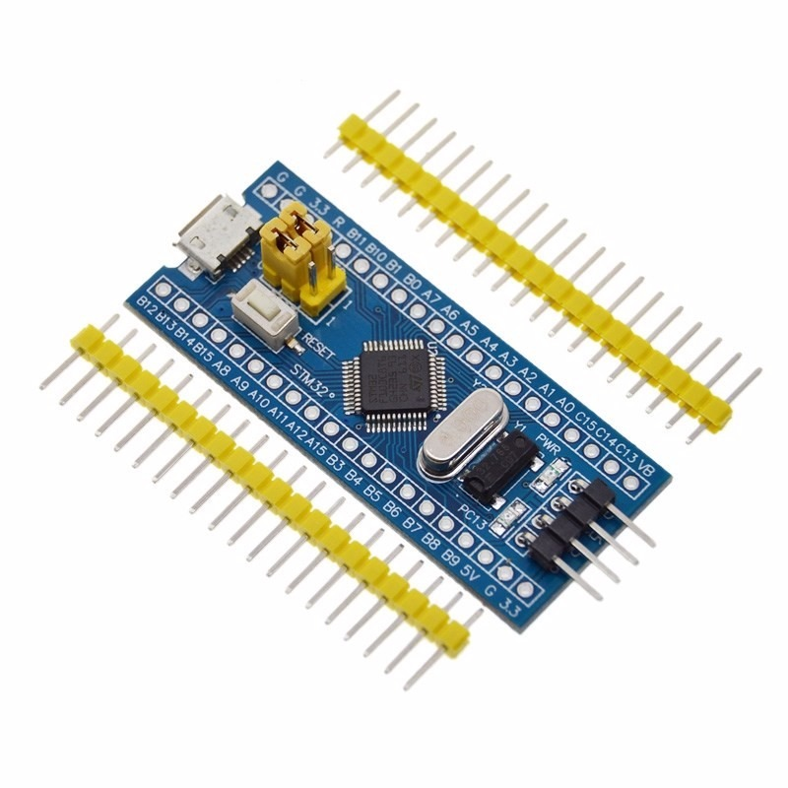
MODULE STM32
The STM32F103C8T6 includes multiple peripherals such as USART, SPI, I2C, and GPIOs, making it suitable for a traffic light system

Slide 9
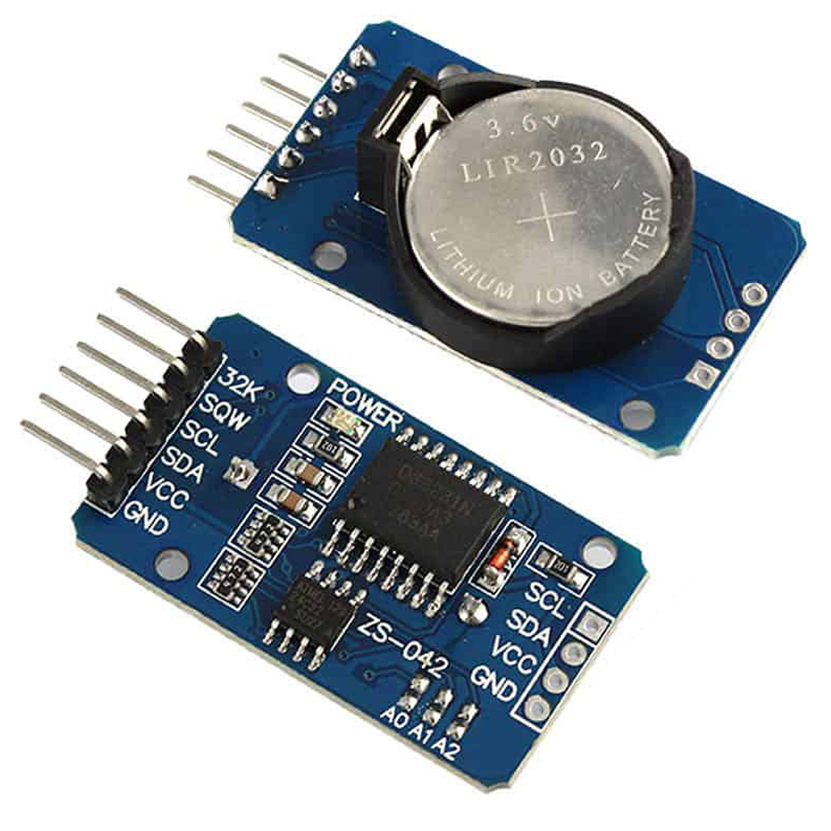
MODULE DS3231
A real-time clock (RTC) module provides accurate timekeeping. The module communicates via the I2C interface and battery backup for continuous operation during power loss

Slide 10
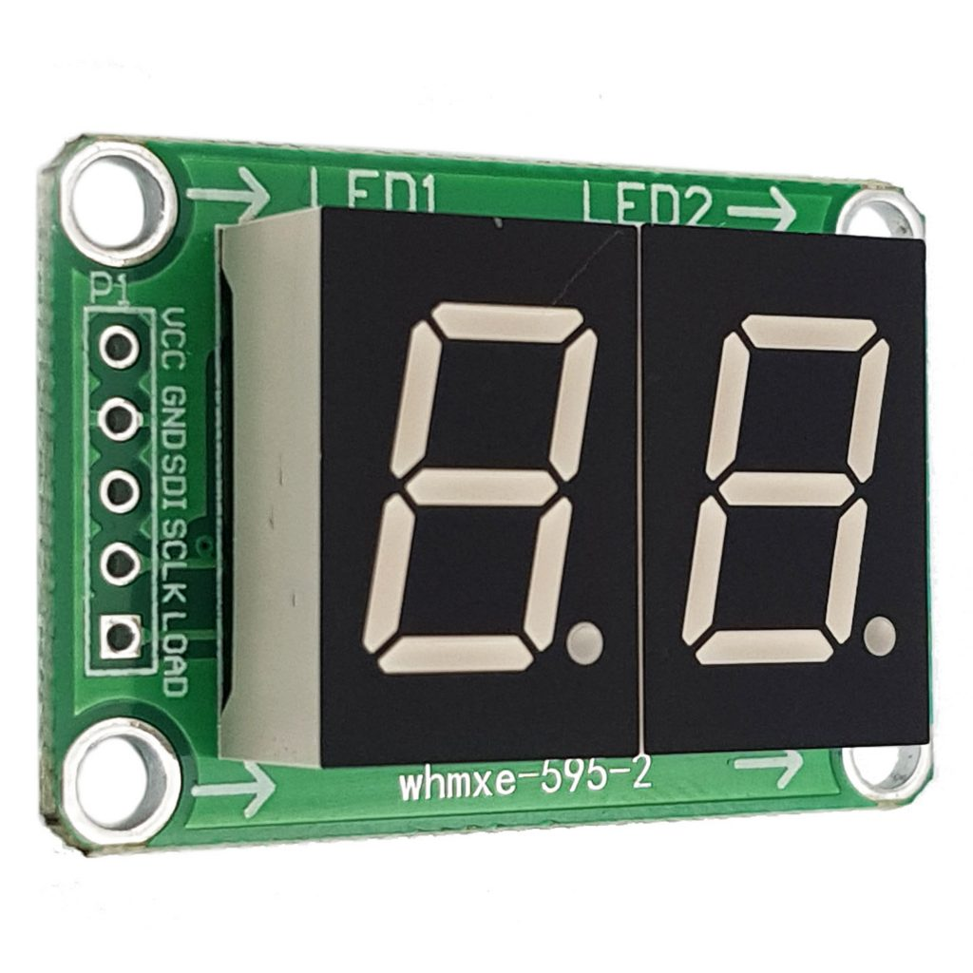
MODULE LED 7 SEGMENT
A module led 7 segment with 74HC595 using SPI interface

Slide 11
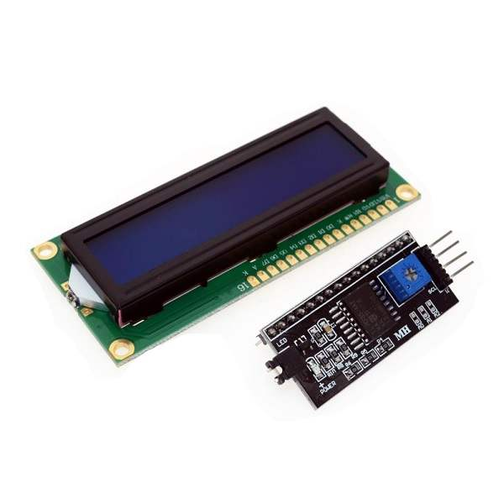
MODULE LCD & I2C
A 16x2 LCD using I2C peripherals with I2C module for easier display

Slide 12
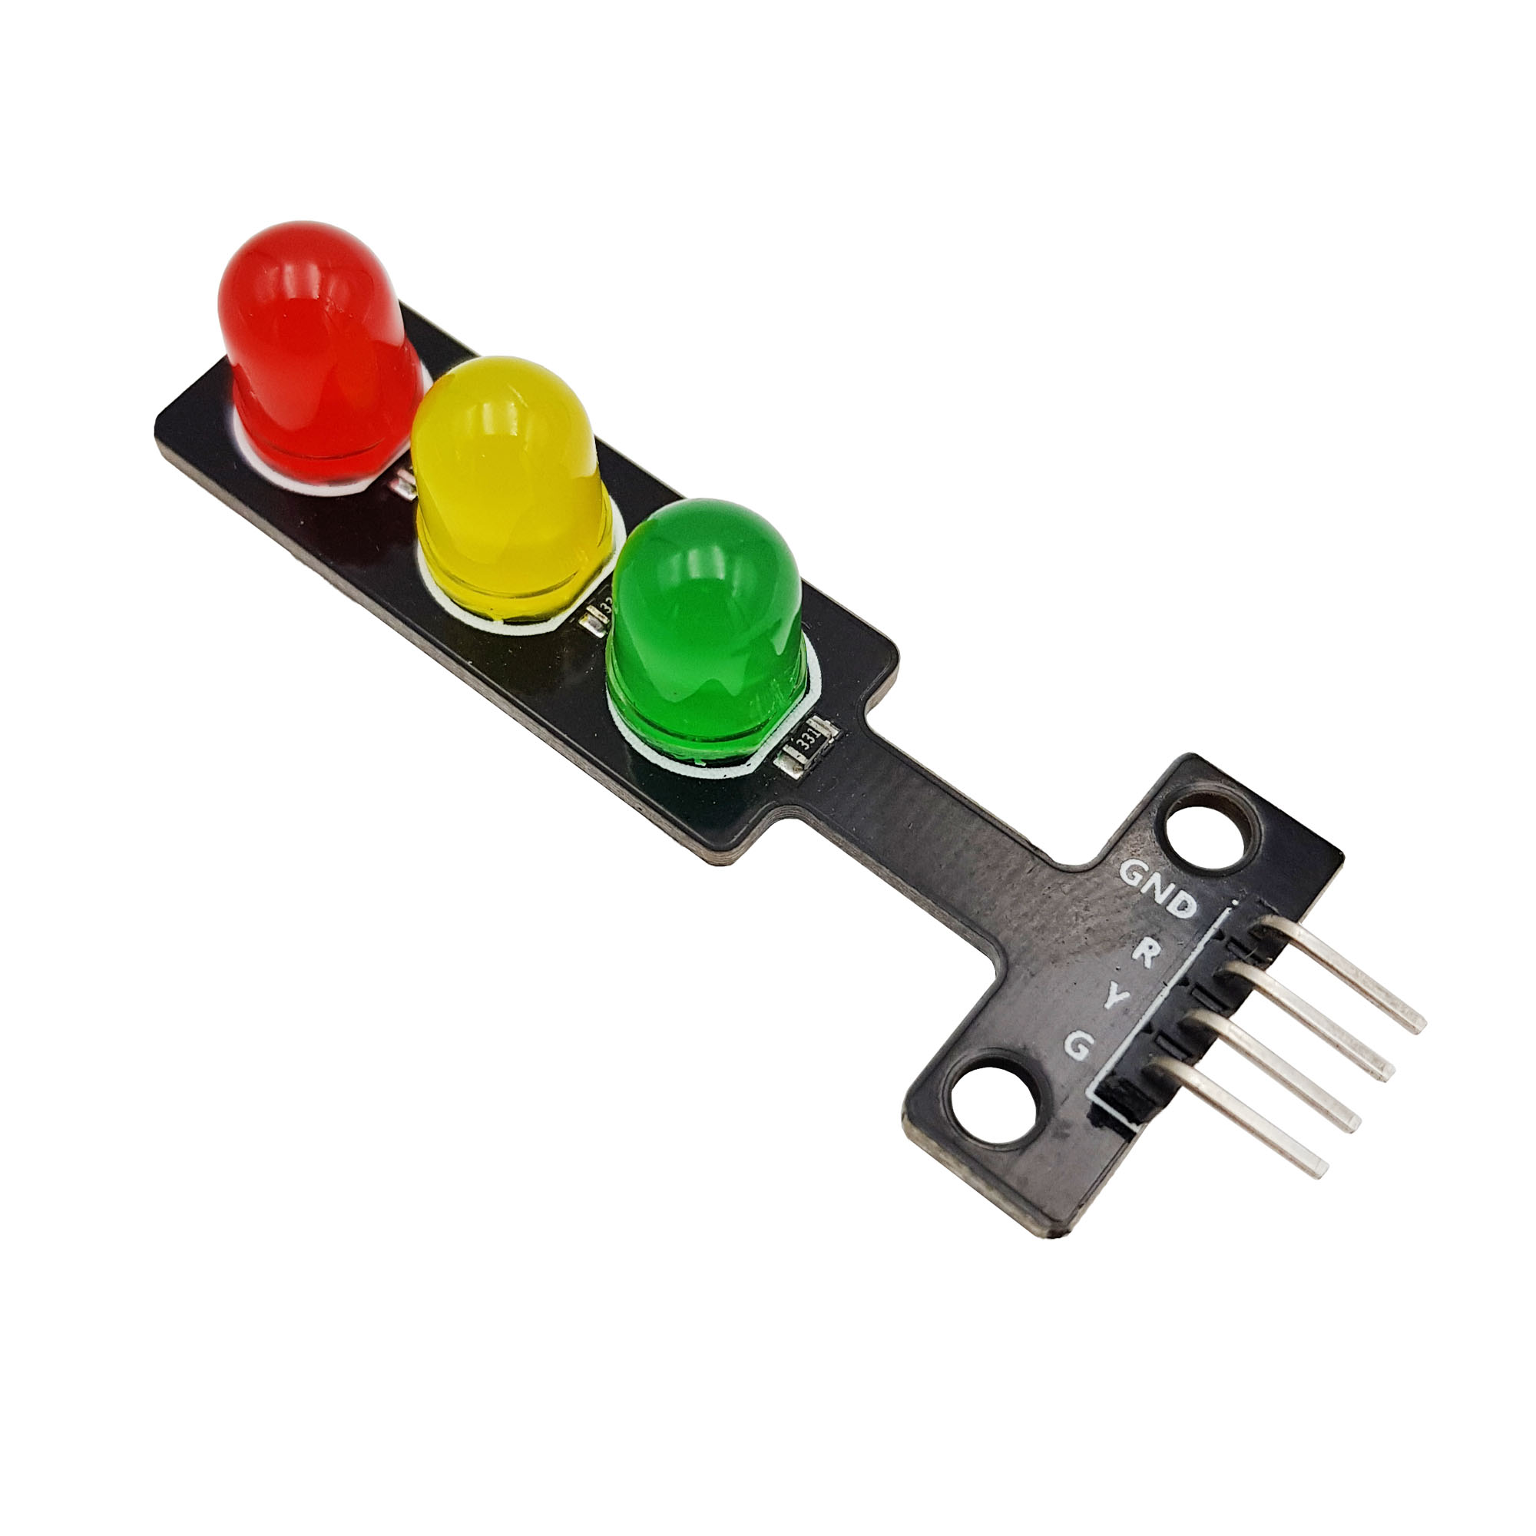
MODULE TRAFFIC LIGHT
A traffic light module is controlled by STM32 GPIO

Slide 13
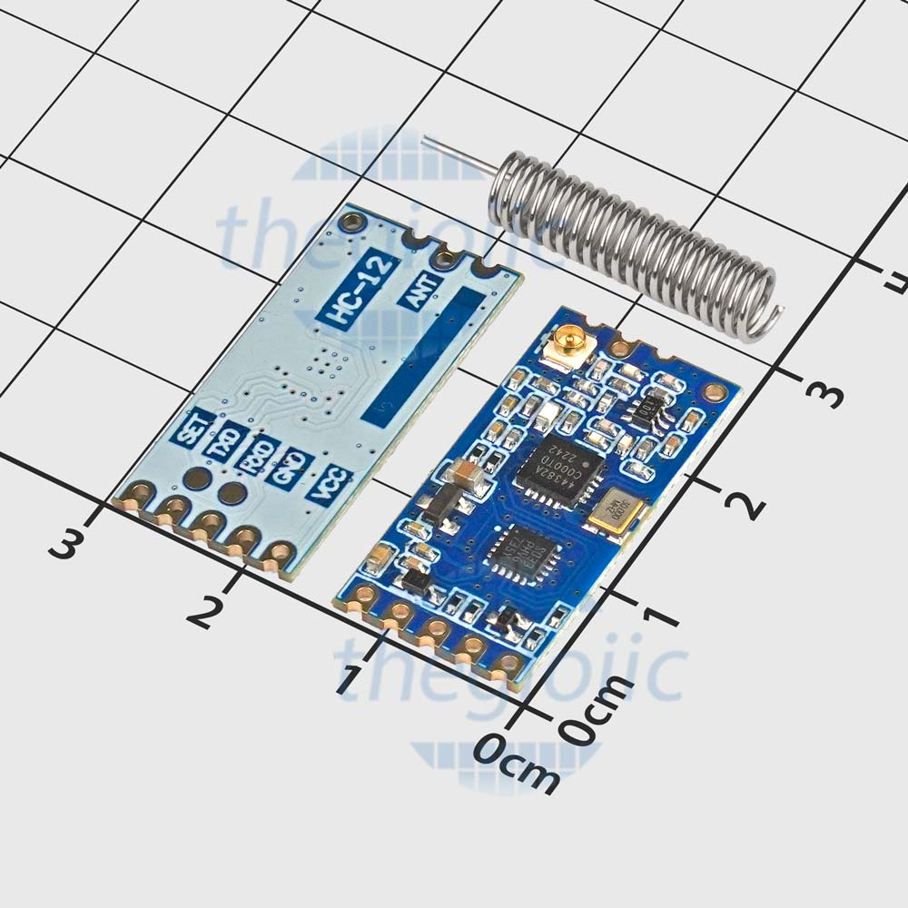
MODULE HC-12
A module using UART for wireless communication under 50 meters

Slide 14
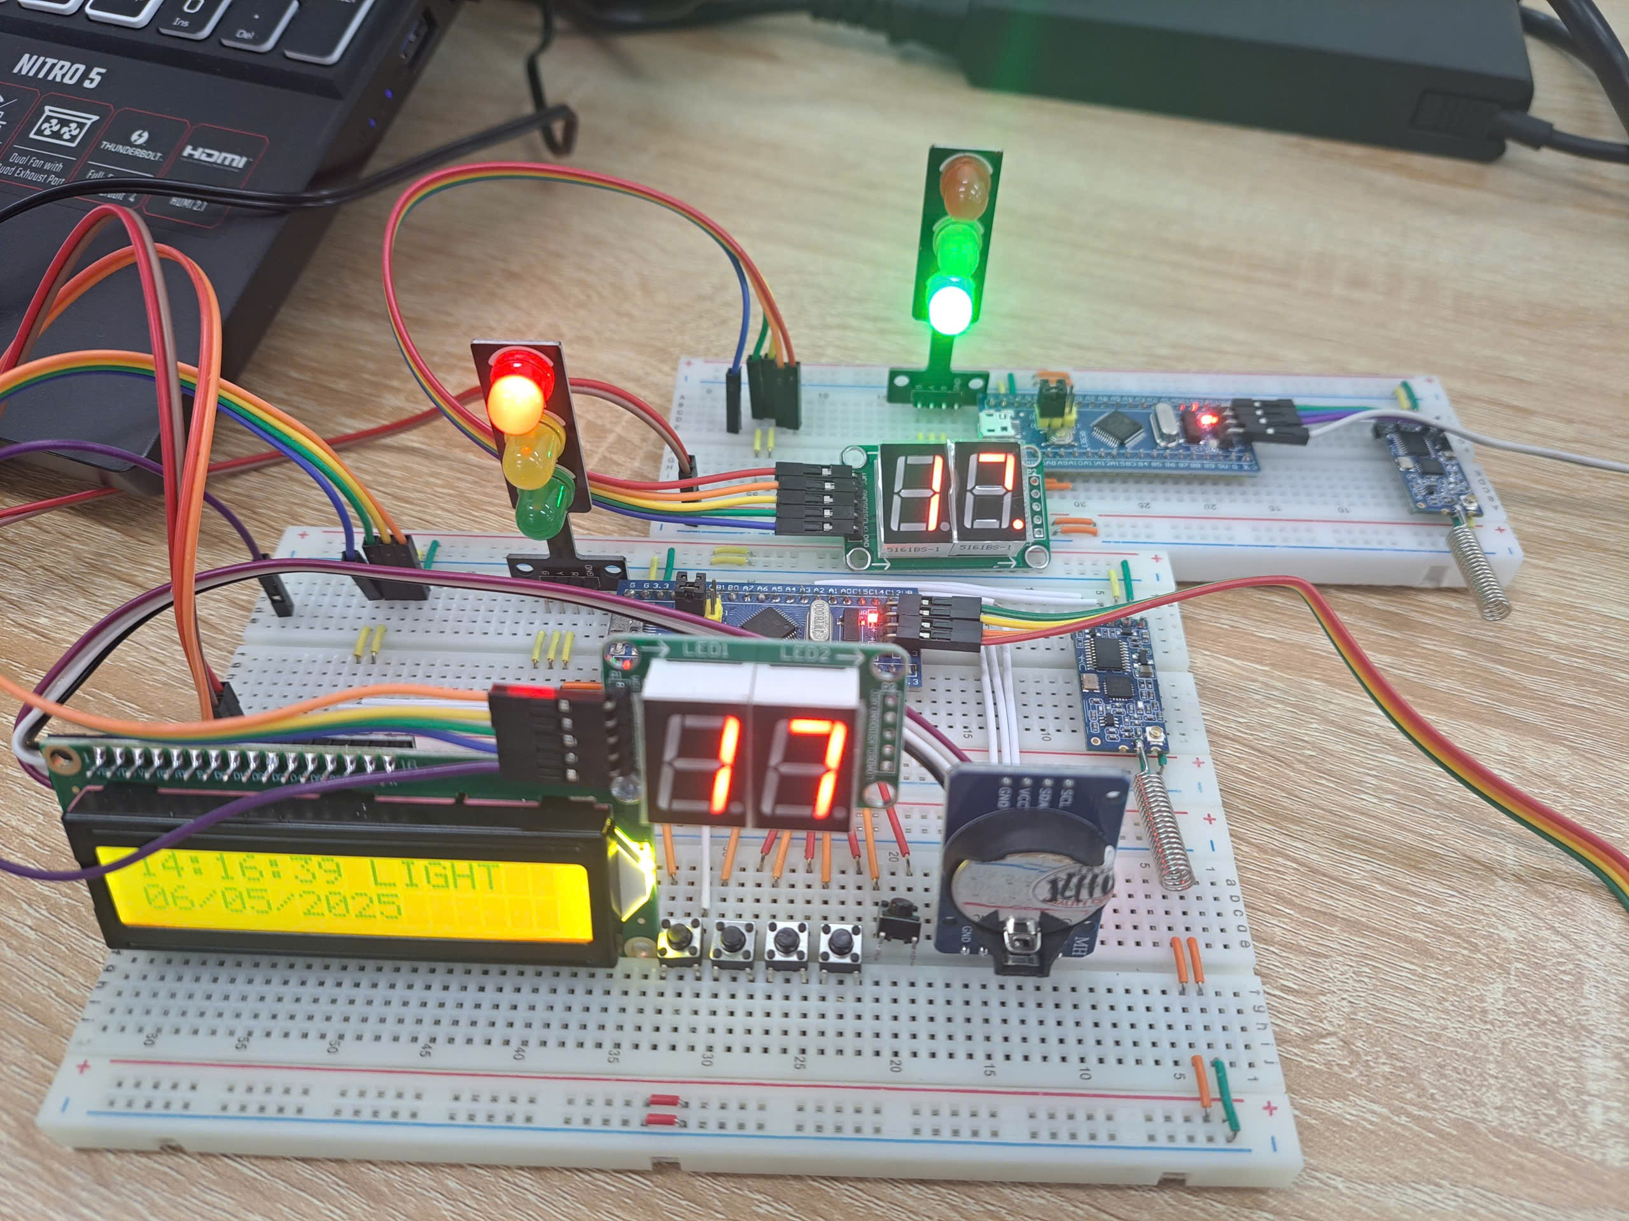
03
IMPLEMENTATION

Slide 15
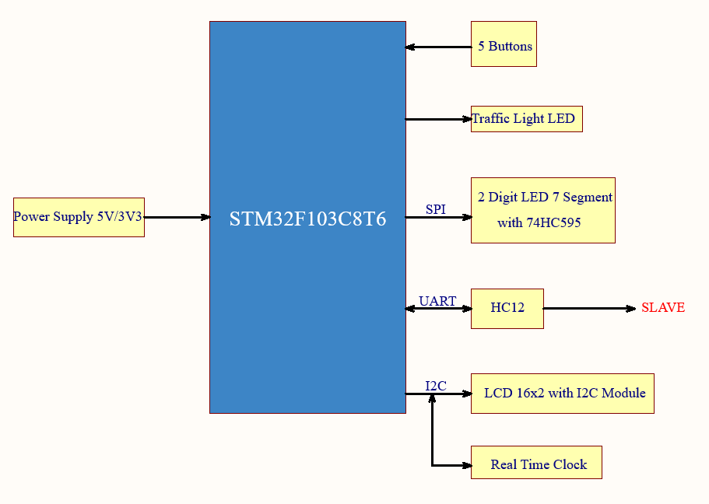
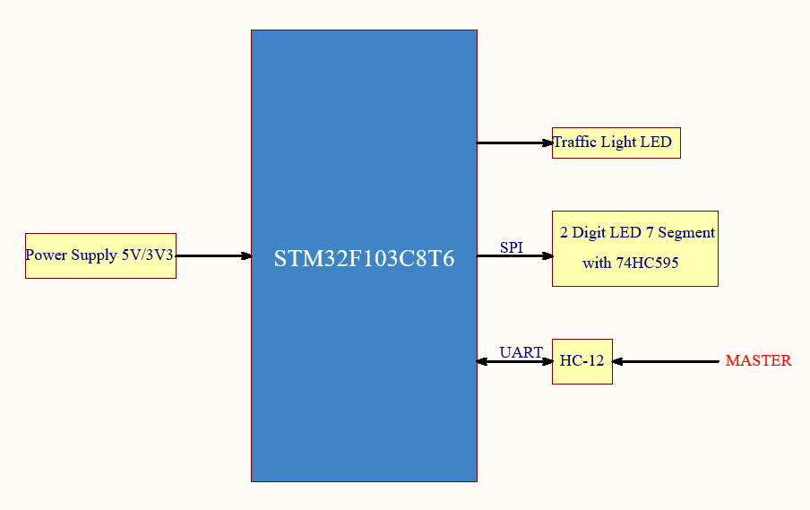
BLOCK DIAGRAMS
MASTER
SLAVE

Slide 16
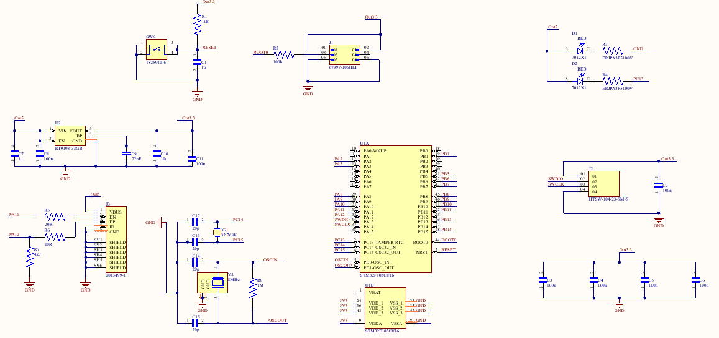
STM32 INTERNAL SCHEMATIC

Slide 17
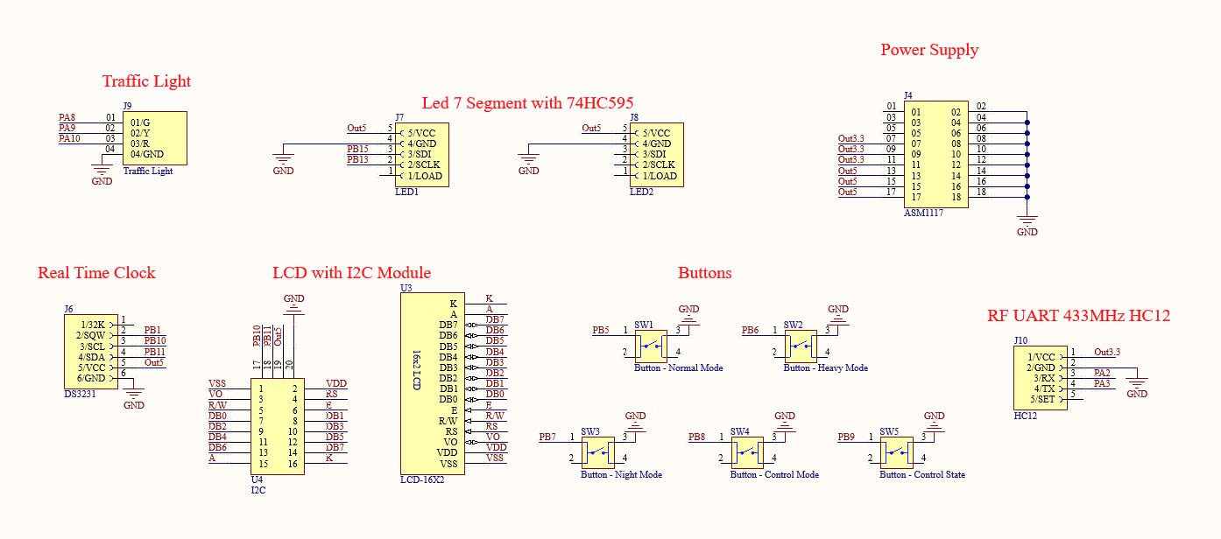
MASTER SCHEMATIC

Slide 18
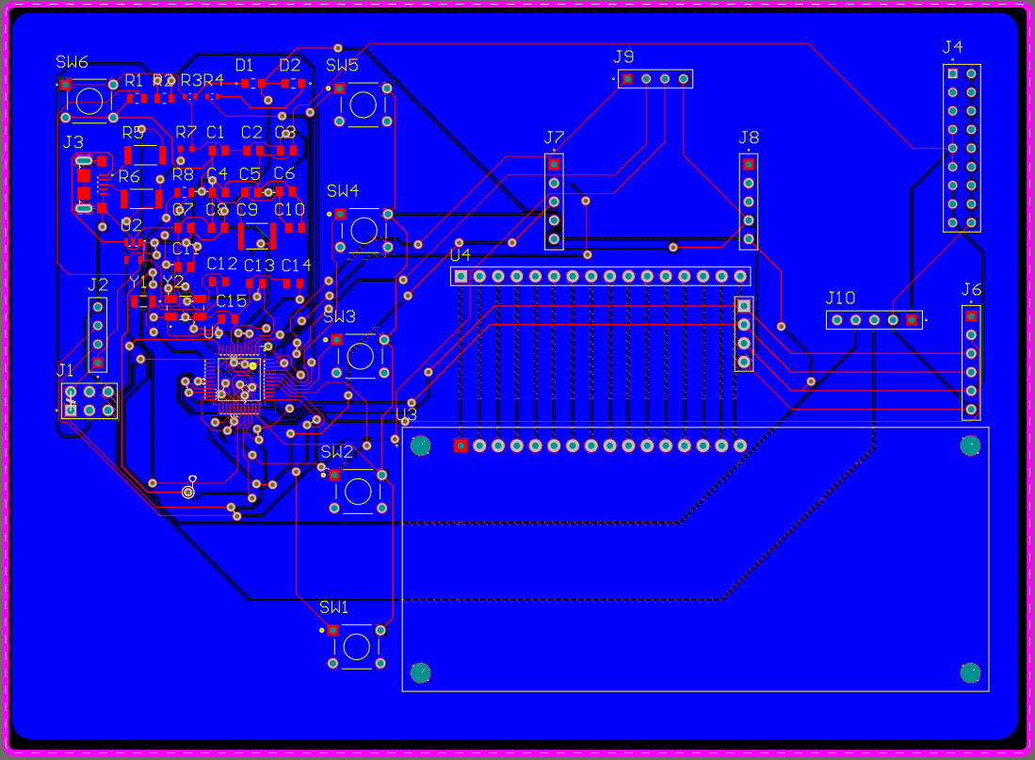
MASTER PCB

Slide 19
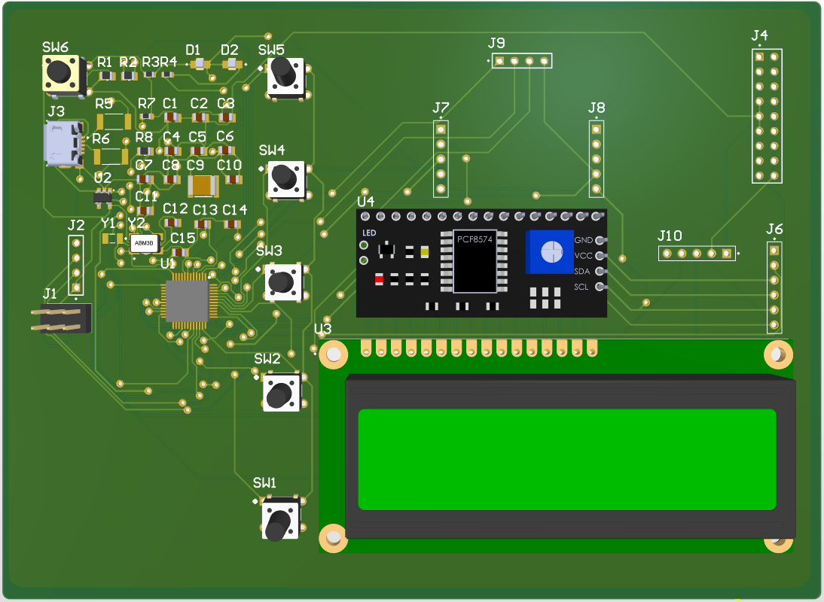
MASTER PCB 3D

Slide 20
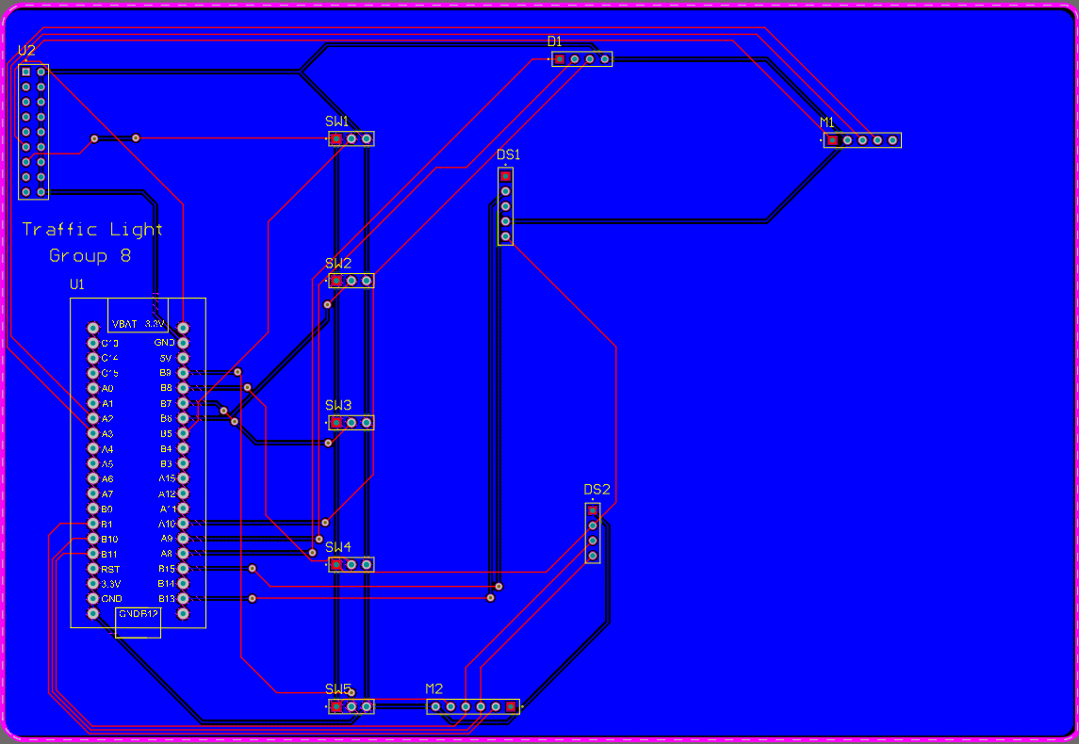
MASTER PCB MODULE

Slide 21
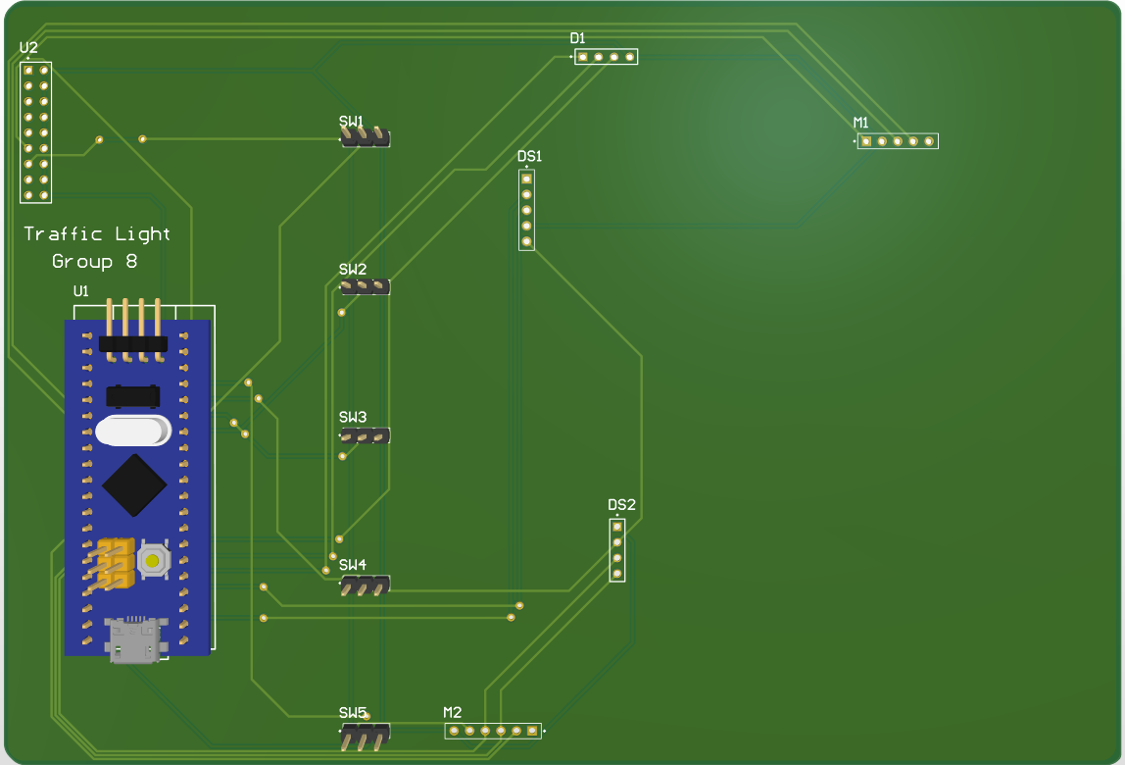
MASTER PCB 3D MODULE

Slide 22
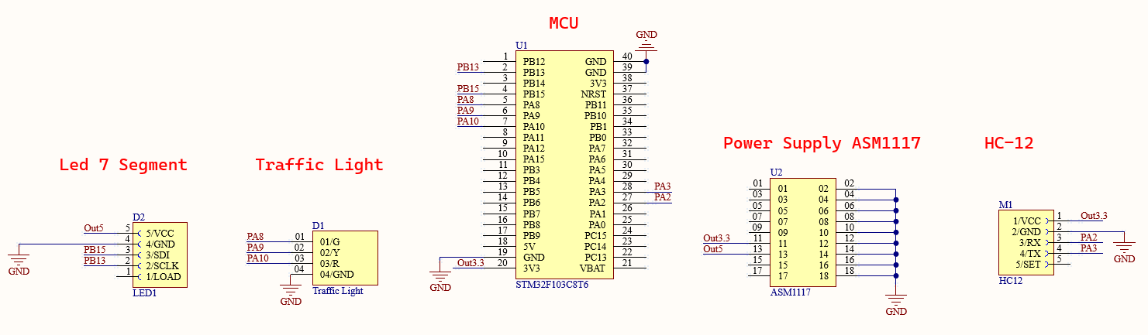
SLAVE SCHEMATIC

Slide 23
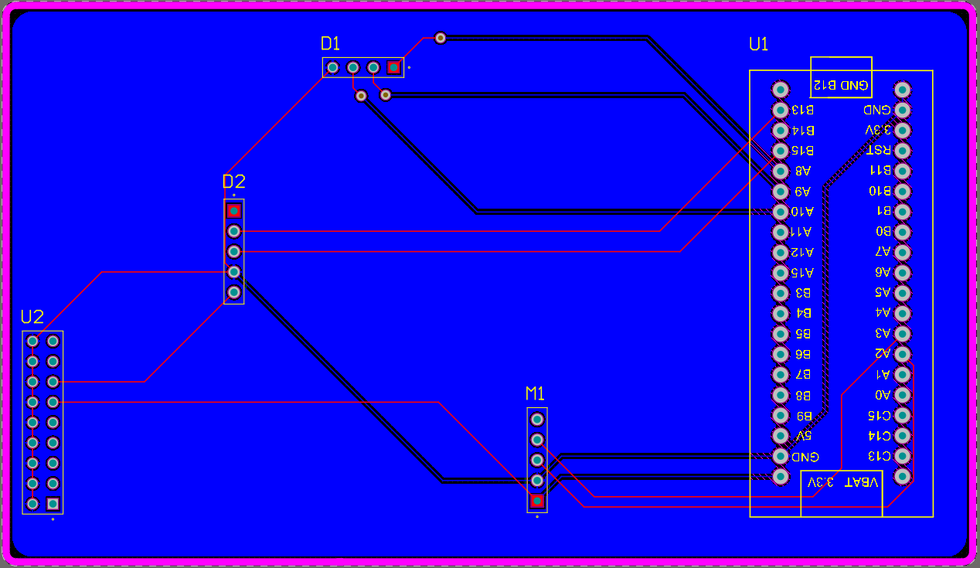
SLAVE PCB

Slide 24
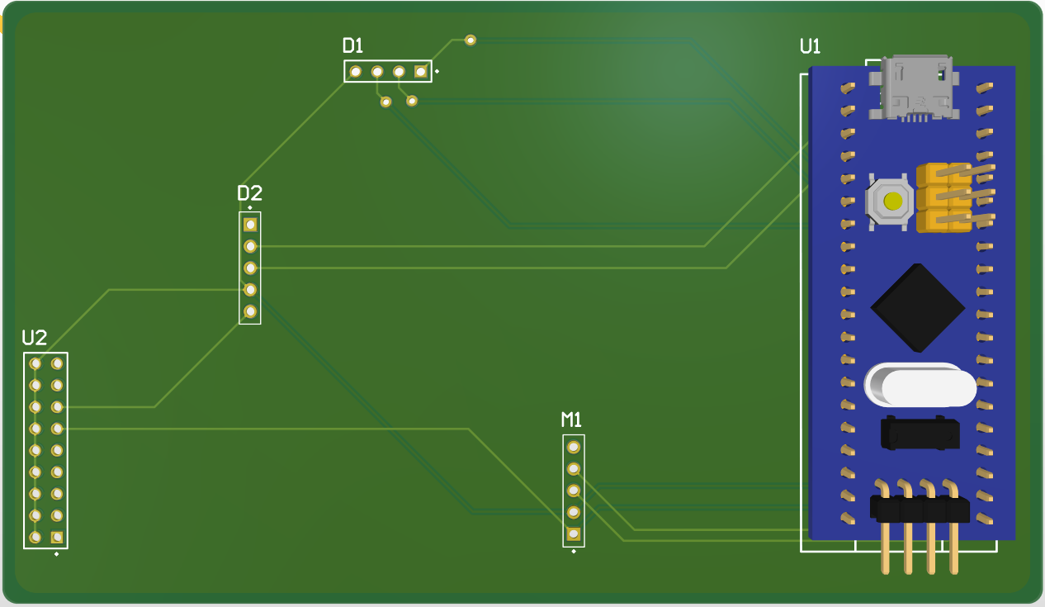
SLAVE PCB 3D

Slide 25
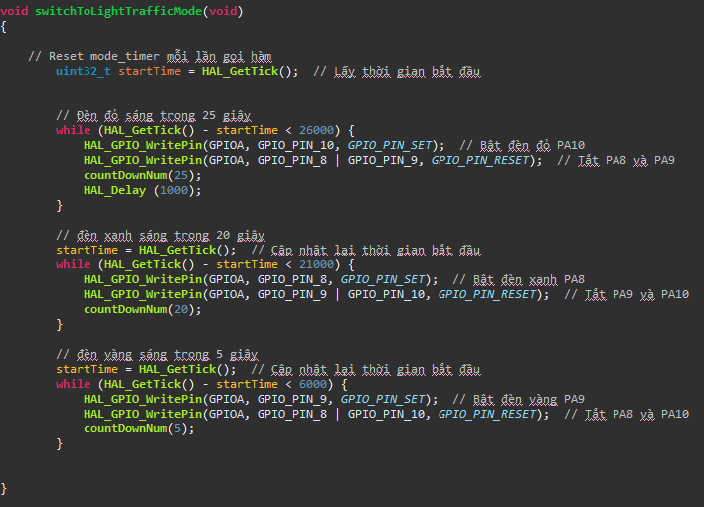
04
FIRMWARE

Slide 26
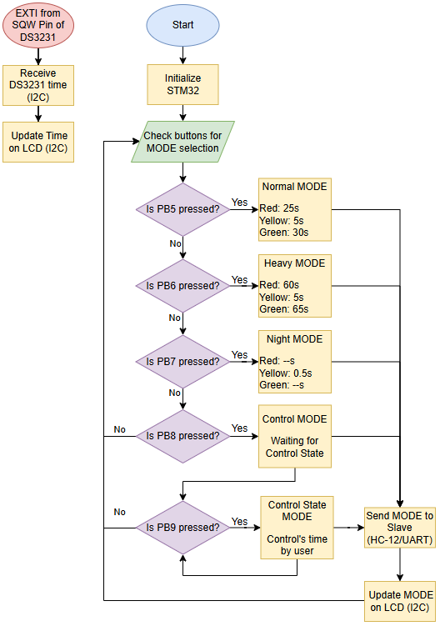
MASTER FLOWCHART
The flowchart provides an overview of how the Master works

Slide 27
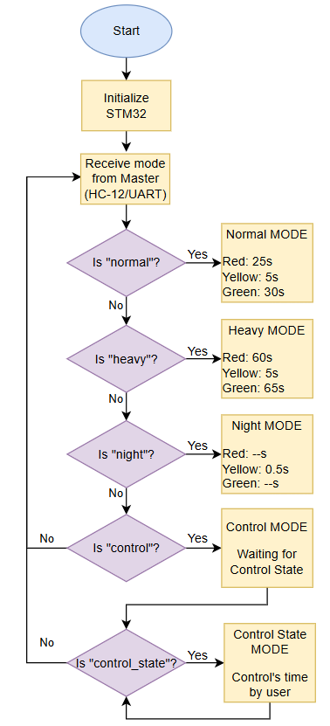
SLAVE FLOWCHART
The flowchart provides an overview of how the Slave works

Slide 28
MODULE FIRMWARE

Slide 29
05
SIMULATION

Slide 30
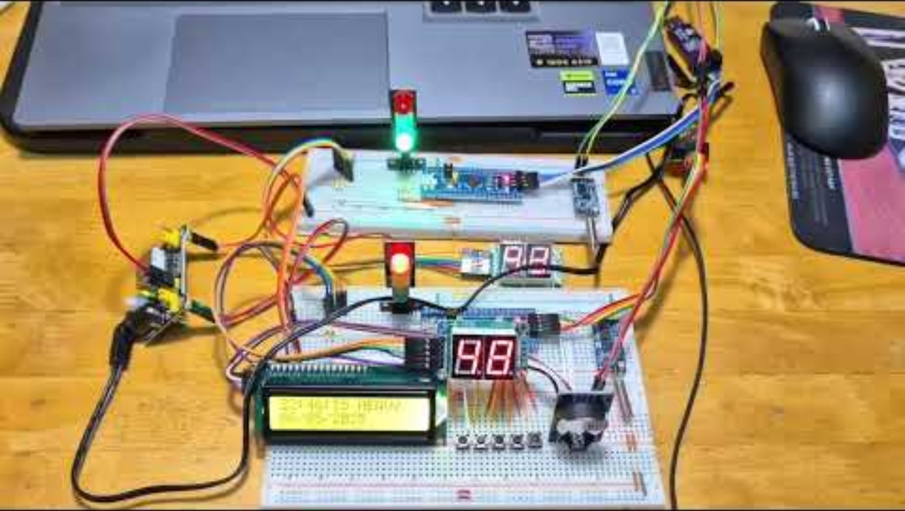

Slide 31
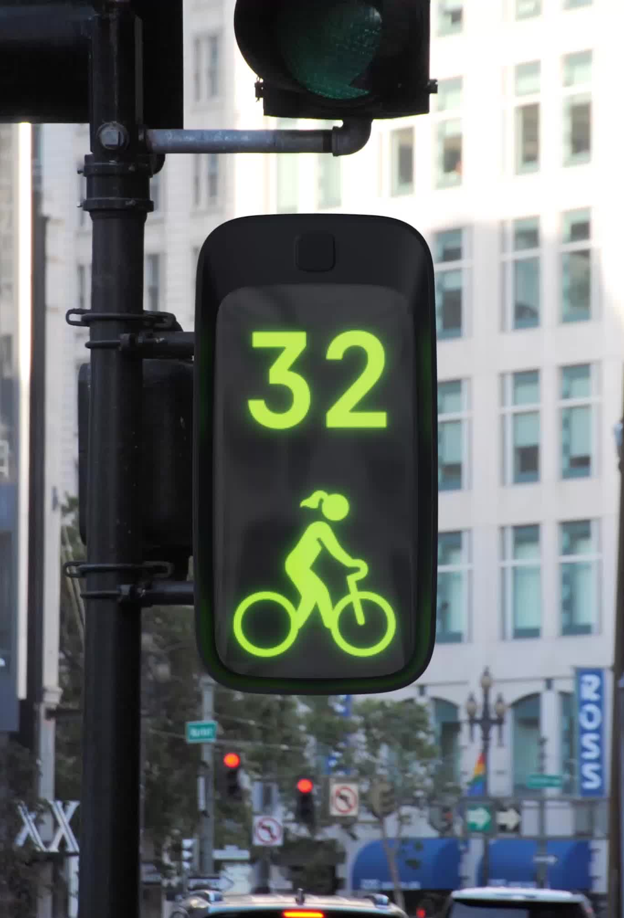
06
CONCLUSION AND FUTURE DEVELOPMENT

Slide 32
Limitation | Improvement Suggestion | Expected Enhancement
Communication limited to 50m and basic HC-12 module | Upgrade to LoRa module | Longer range communication
No traffic monitoring or violation detection | Add a surveillance camera with image processing to detect license plates and red-light violations | Enhance security, collect evidence of traffic violations
No response to emergency vehicles | Integrate a priority signal detection module (e.g., RF, LoRa, or sound detection) | Automatically adjust traffic lights for ambulances or police cars, reduce response time

Slide 33
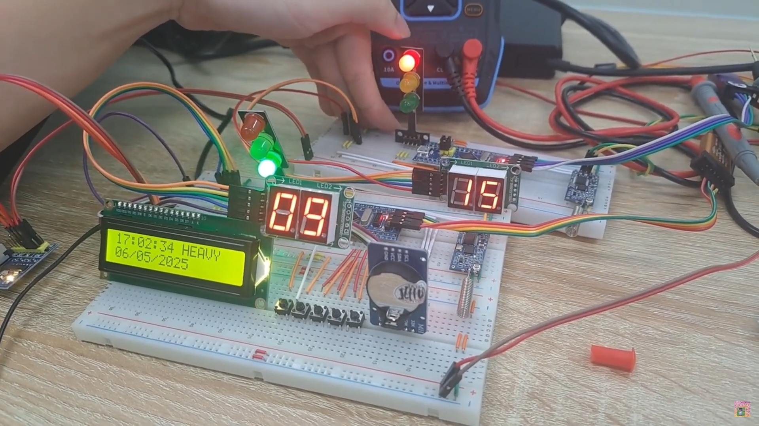
THANKS!
Do you have any questions?

